Slide 1


New Technologies for Education & School
Simon Wong
Senior Product Manager
SiS International Ltd. – Samsung Commercial Products Distributors

Slide 2
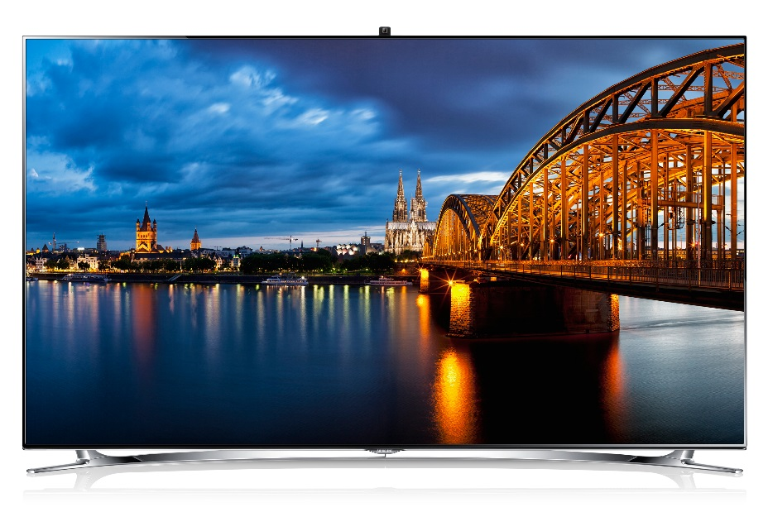


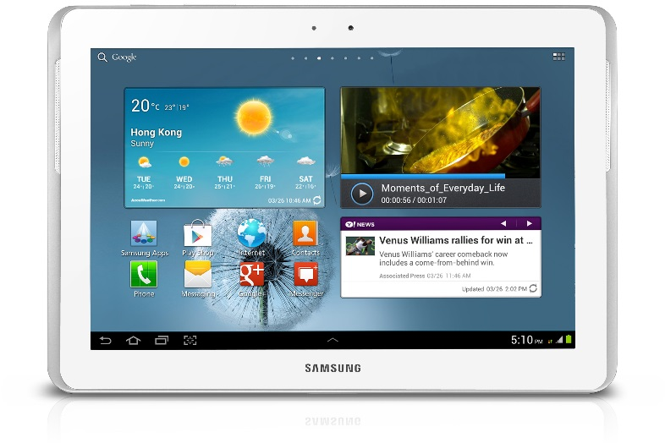
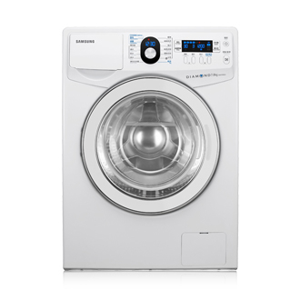
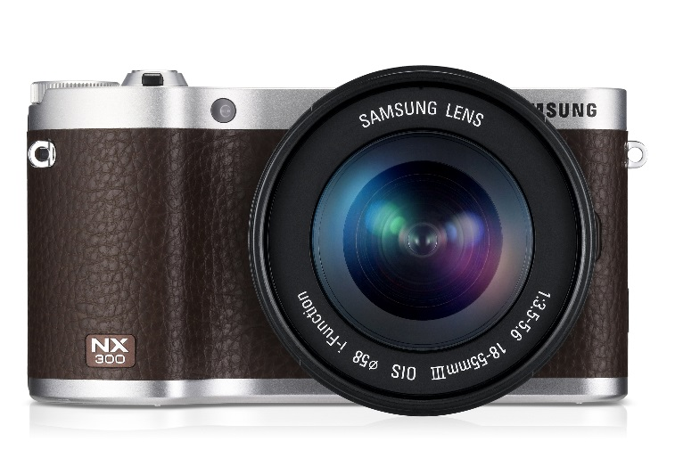
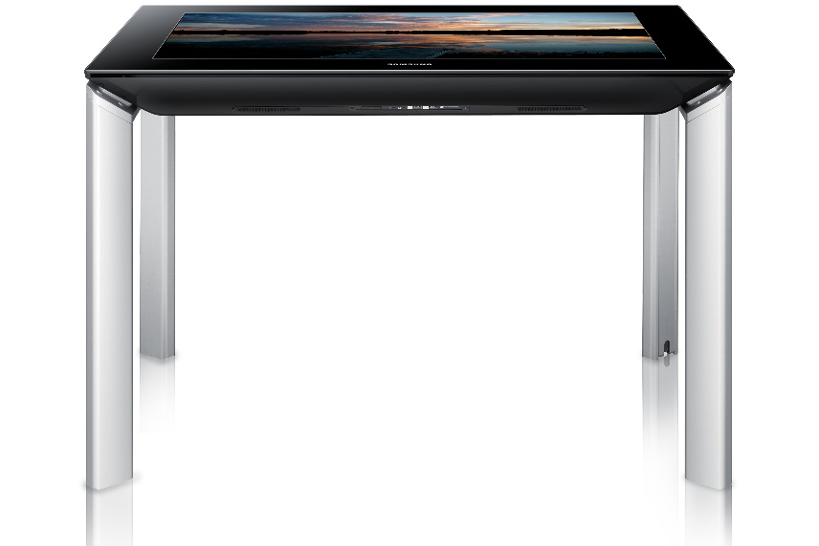
When you see Samsung logo…..

Slide 3
New trends of education environment
Access to anywhere, anytime learning during and after school hours
Intra-school and classroom connection and collaboration between students, parents and teachers
Intuitive and easy-to-use devices for younger learners (mobile, lightweight devices with touch-screen user interfaces)
Educational applications and digital content such as digital textbooks
Security solutions that ensure a safe and protected learning environment for students

Slide 4

Education spending in it devices

Slide 5

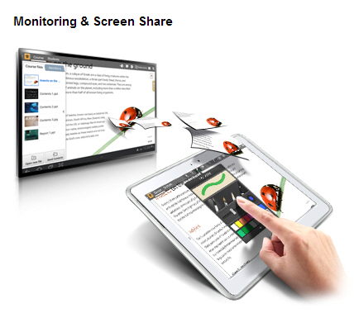

Samsung Smart School

Slide 6

Samsung Smart School - Video

Slide 7
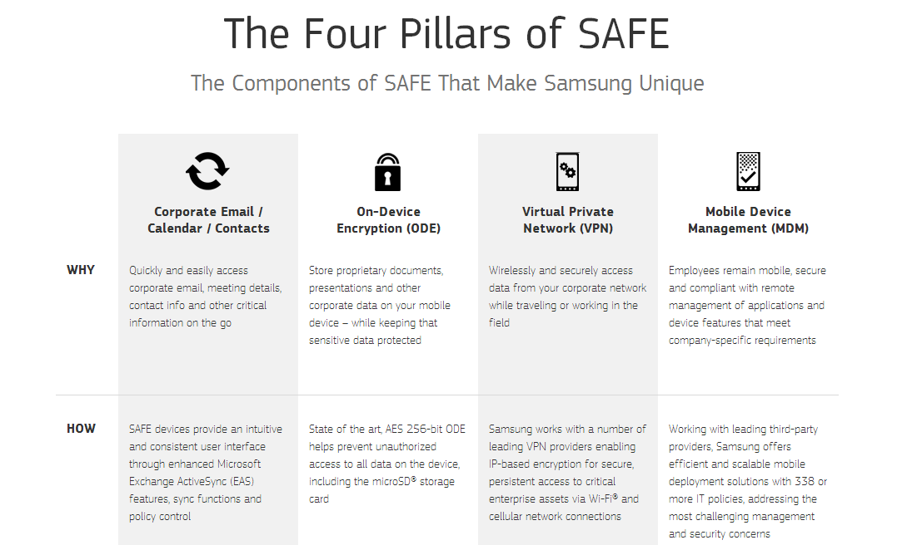

Slide 8
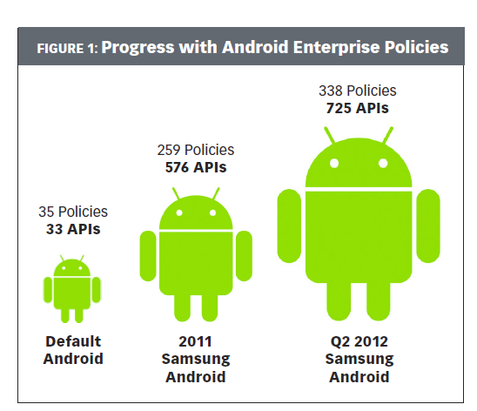
Samsung GALAXY Enterprise-MDM
Remote configuration. Over-the-air secure configuration distribution of Exchange ActiveSync, Cisco AnyConnect, IMAP and POP3 email, Wi-Fi, Access Point Name (APN), Web proxy and other settings.
Inventory monitoring. Visibility into details about the device, such as total memory usage, installed application list and OS version.
Application management. Ability to install and remove apps, disable and enable apps and enforce IT policy about which applications must be deployed (“whitelisting”) and which should be blocked (“blacklisting”).
Kiosk mode. Ability to simplify the user interface by presenting only the required applications, disabling hardware keys such as “power off” and removing the notification bar.

Slide 9
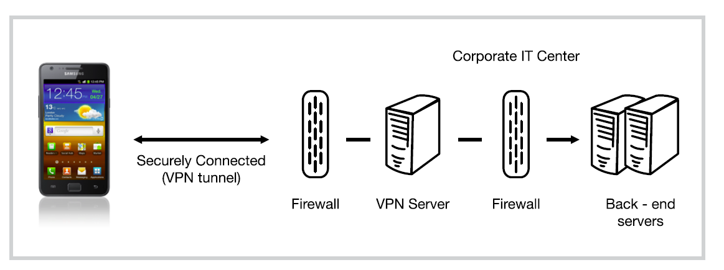
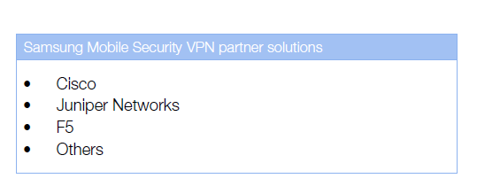
Samsung GALAXY Enterprise-VPN
secure path to corporate resources from their device:
• Corporate intranet and email
• Network resources
• Software applications

Slide 10
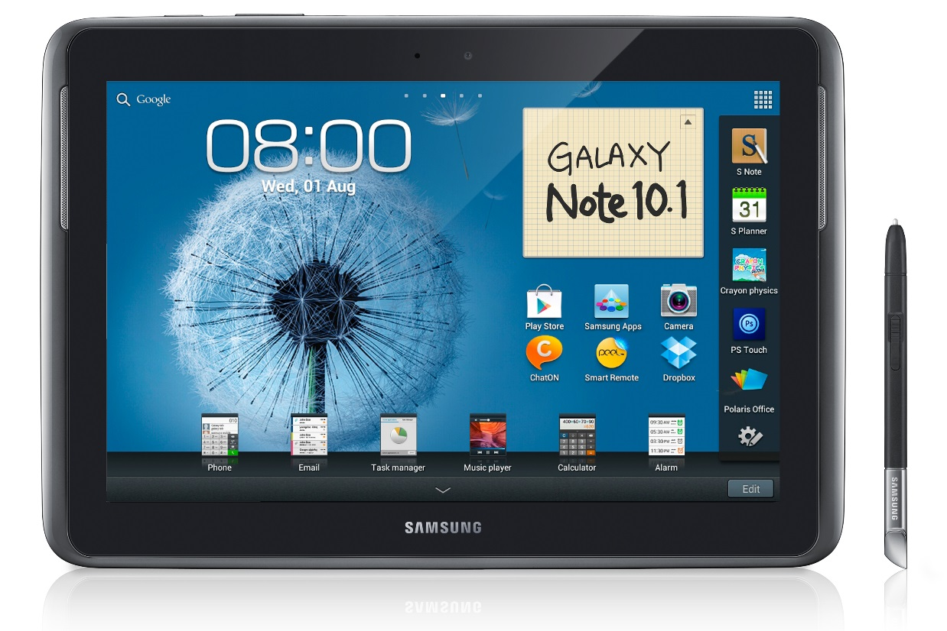
Galaxy Note 10.1
Display
  Technology: 16M color PLS Full Touch Display
  Resolution: 1280 x 800pixel
  Size: 10.1"
Memory
  User Memory: 16GB (RAM: 2GB)
  External Memory: microSD, up to 64GB
Input Method
  Hand Writing Recognition (English, Traditional, Simplified Chinese, number and symbol)
Processor
  1.4GHz Quad Core Processor
Battery
  Capacity: 7,000 mAh
Smart Featureˇ
  S Pen main feature:
  - Video & Image Screen Capture
  - Cut & Paste
  - Precise Writing & Drawing
  - Handwriting to Text
  - Pen & Text Settings
  - Wrist Touch (for S Note)
  Adobe® Photoshop® PS Touch

Slide 11
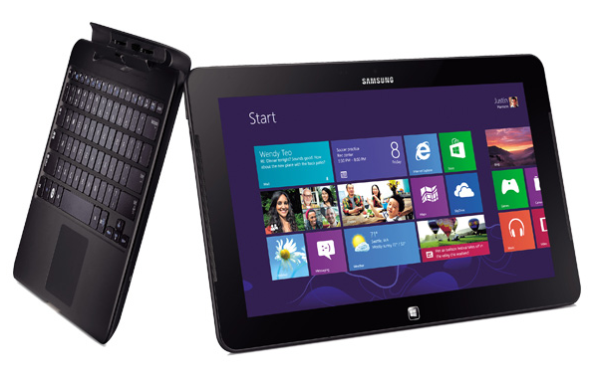
Smart PC
Operation System
  Windows 8 Pro (64-bit)
Processor / Chipset
  Intel® Celeron 847 / Core i5 Processor 3317U (1.70 GHz, 3 MB L3 Cache)
Ram
  2GB / 4GB
Display
  11.6" FHD LED Display (1920 x 1080)
Hard Drive
  128GB Solid state Drive
Special Features
  10-finger Multi-touch Capability
  Precision S Pen, 1024 level pressure sensitivity
  2.0 megapixel Webcam (front), 5.0 megapixel Webcam with Flash (rear)

